Slide 1
Team From the Orient
Machine Learning Project
Predict House prices in Ames, Iowa with Python
By Charlie Wang, Heqian Li, Weixing Yang

Slide 2
Agenda
Data Manipulation
Feature Engineering
Modeling and CVs
Ensemble

Slide 3
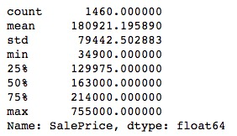
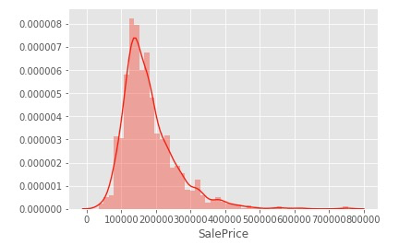
Data Manipulation
Check target variable:

Slide 4
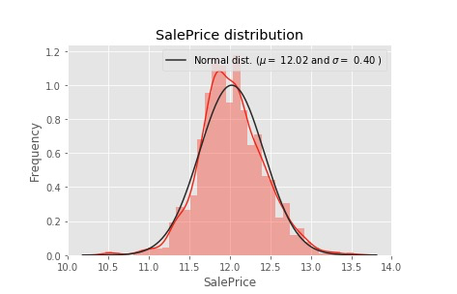
Log Transform
Use log to convert target variable to normal distribution

Slide 5
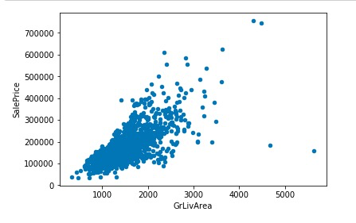

Exception handling
Remove outliers Remove meaningless variables: ID & Utilities

Slide 6
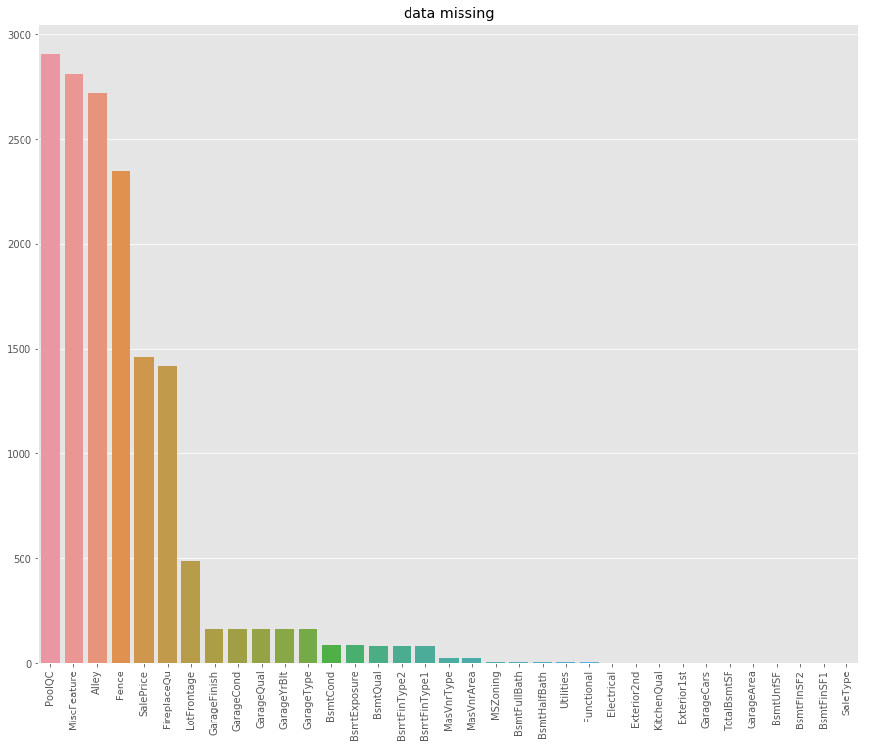
Processing of missing data

Slide 7
Processing of missing data
Numeric Group: ["MasVnrArea", "GarageYrBlt", "TotalBsmtSF", "BsmtFinSF1", "BsmtFinSF2", "BsmtFullBath", "BsmtHalfBath", "BsmtUnfSF", "GarageArea", "GarageCars"] -> fill 0
Category Group: "BsmtCond", "BsmtQual", "BsmtFinType1", "BsmtExposure", "BsmtFinType2", "GarageType", "GarageFinish", "GarageQual", "GarageCond", "Alley", "FireplaceQu", "PoolQC", "Fence", "MiscFeature", "MasVnrType", "KitchenQual", "Exterior1st", "Exterior2nd" ---> fill "None"
Special Cases: LotFrontage ---> fill median, ‘Electrical’,’MSZoning’,’KitchenQual’,’Exterior1st’,’Exterior2nd’,’SaleType’ ---> fill frequent patterns

Slide 8
Used Model
Lasso
Ridge
ElasticNet
Random Forest
Gradient Boosting
Extreme Gradient Boosting

Slide 9
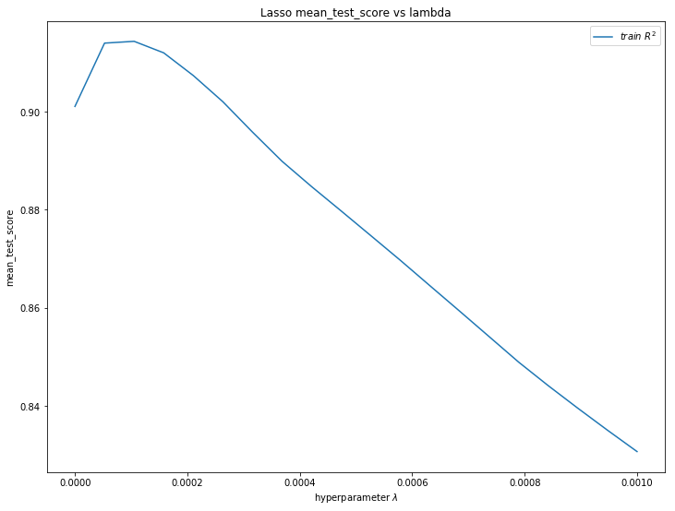
Lasso Regression
Using Alphas in the range of 0 to 0.001
Run the GridSearvhCV to find the best lambda for Lasso
We have the best lambda with 0.0001052

Slide 10
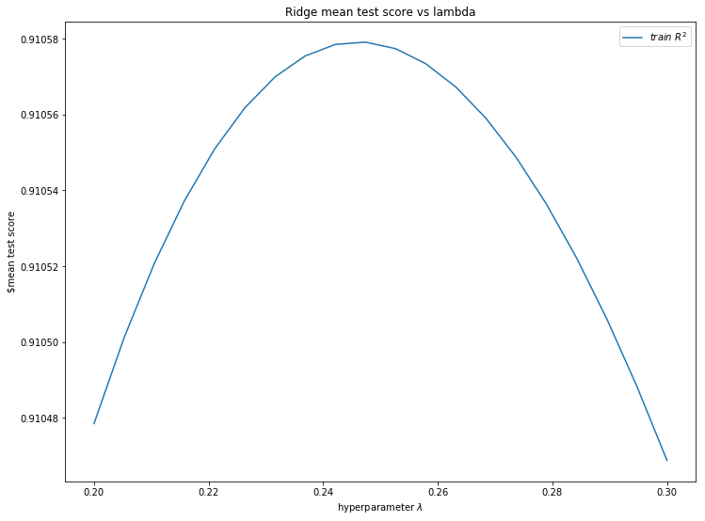
Ridge Regression
Using Alphas in the range of 0.2 to 0.3
Run the GridSearvhCV to find the best lambda for Ridge
We have the best lambda with 0.2526

Slide 11
Best Parameter & CV Score for Models
Model | Best Parameter | Best CV Score
Lasso | Alpha = 0.0001 (0~0.001) | 0.9143
Ridge | Alpha = 0.2474 (0.2~0.3) | 0.9107
ElasticNet | Alpha = 0.0001(0~0.001) L1r_ratio = 0.5333 (0.3~0.6) | 0.9142
Random Forest | Maximum depth = 20 (10~20) Number of tree = 1000 (500~1000) | 0.8844
Gradient Boosting | Learning rate = 0.03 The number of estimators is 3000 (1000~3000) Maximum depth of estimators is 3 (2,3,5) | 0.9203
Extreme Gradient Boosting | Shrinkage (learning rate) = 0.01 Maximum depth of a tree = 3 Number of boosted trees are 900 | 0.9129

Slide 12
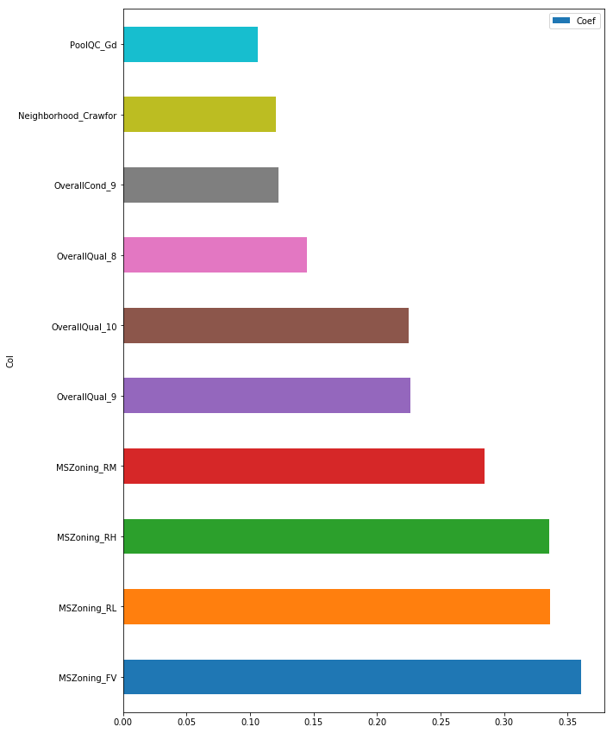
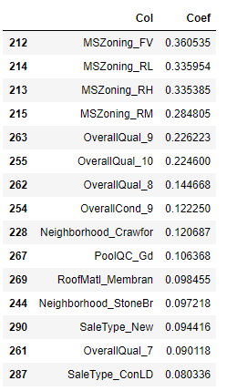
Important Feature in Lasso

Slide 13
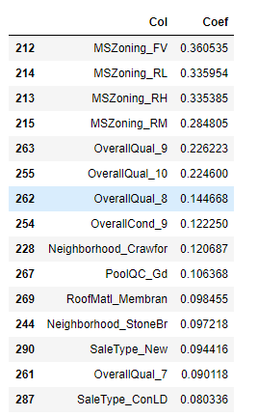
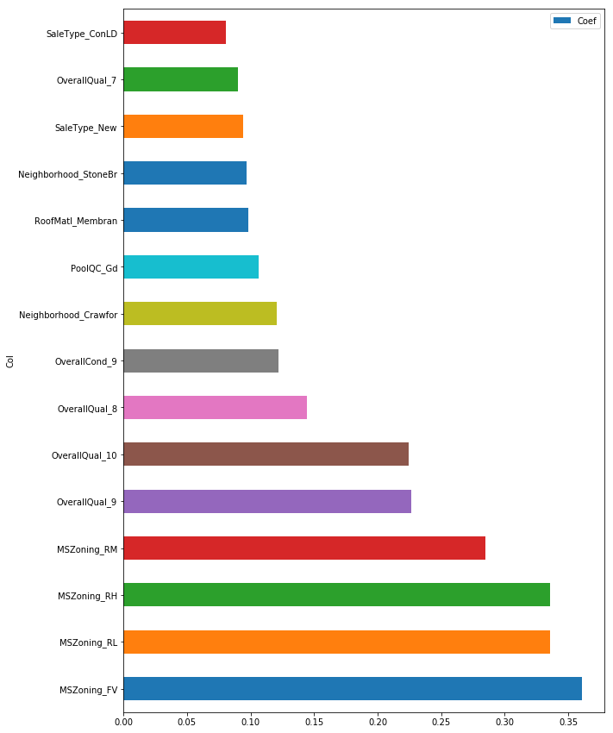
Important Feature in Ridge

Slide 14
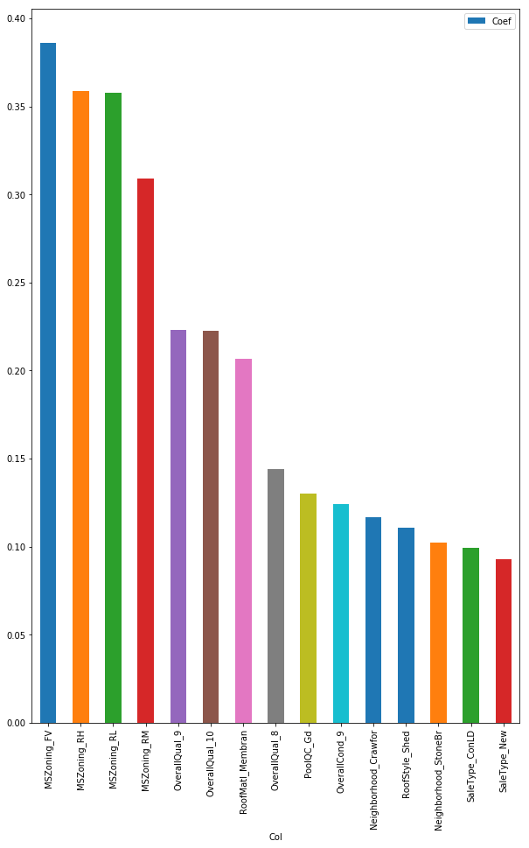
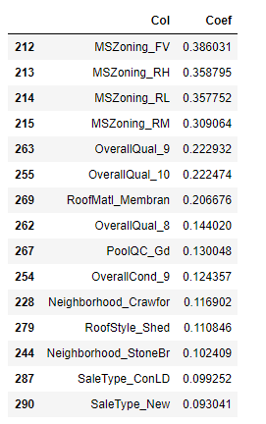
Important Feature in ElasticNet

Slide 15
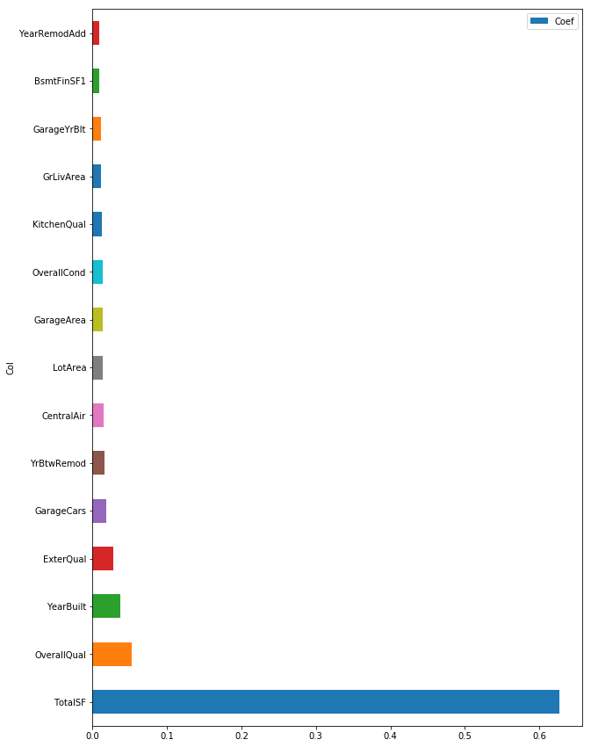
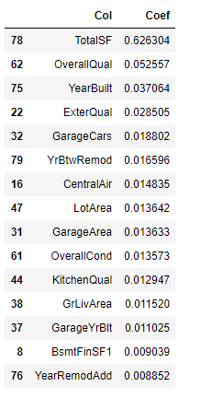
Important Feature in Random Forest

Slide 16
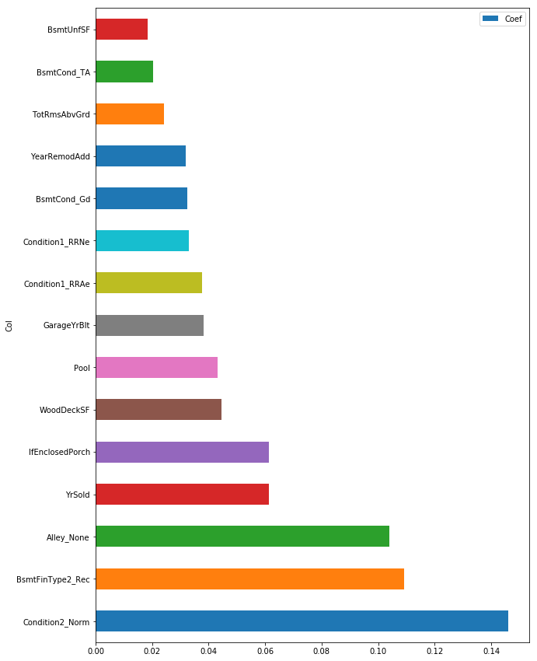
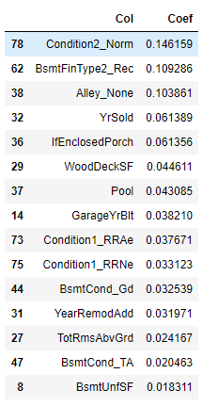
Important Feature in Gradient Boosting

Slide 17
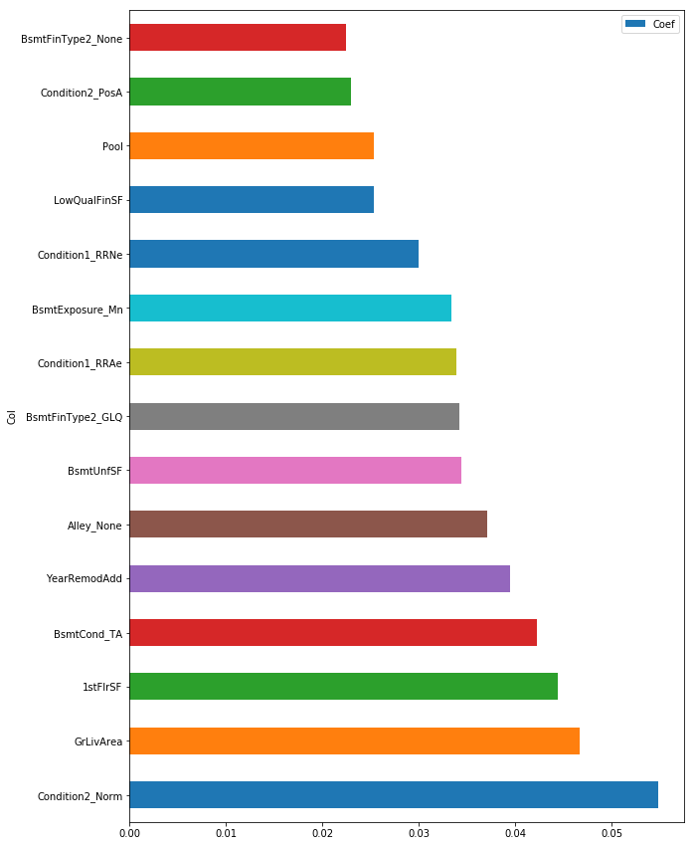
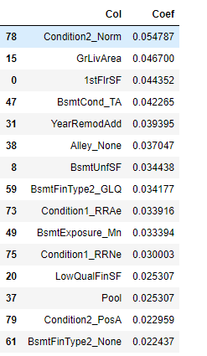
Important Feature in Extreme Gradient Boosting

Slide 18
Combination of all the important Feature
After compare with all of the above model, we decide to eliminate the following features: Alley, BsmtFinSF2, BsmtHalfBath, , Condition2, EnclosedPorch, MasVnrArea, MoSold, YrSold;
Re-run the model with less features;
Found out most of model perform slightly worse than using nearly completed features;

Slide 19
Result after reducing feature
Model | Original Score | After reducing feature
Lasso | 0.9143 | 0.9080
Ridge | 0.9107 | 0.9042
ElasticNet | 0.9142 | 0.9099
Random Forest | 0.8844 | 0.8827
Gradient Boosting | 0.9203 | 0.9184
Extreme Gradient Boosting | 0.9129 | 0.9100

Slide 20
Predicting and CVs
Models:
Lasso, Ridge and Elasicnet
RFs, Gradient Boosting and Extreme Boosting
Results:
Best single model: Lasso, test error 0.12755
Lasso with TotalSF and YrBtwRemode: 0.12298

Slide 21
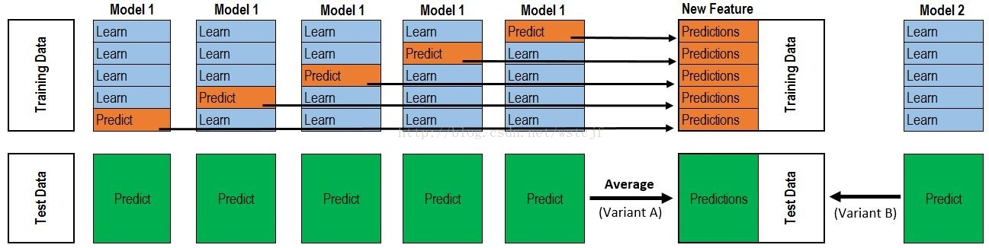
Models Ensemble
Weighted Average
(Lasso + XGboost)/2 3% imp
Lasso * 0.5+ XGboost * 0.25
GBM * 0.25 0.11936
Stacking
Base Models: Lasso + Ridge + ElasticNet + GBM + XGboost
Meta Regressor: MLR

Slide 22
What We Learned
Feature Engineering > Model Selection > Model Ensemble
Adding > Removing Features
It is better to ensemble more diverse models
“90% of Data Scientists’ time is spending on data preprocessing” is True.

